Slide 1
Advanced leadership training
whatswright.com
with Pastor Bryan Wright
Notes:
Welcome!​
Notes are yours to keep​
- What you will see today is a SNAPSHOT​
- We call this Advanced because our experience has shown us that the vast majority of organizations are NOT utilizing these principles.​
- BUT this is our starting point of leadership​
- Will work with any organization: church, business, family, etc​
- Can & should be customized: ie: small/big, staff/volunteers, etc​
- To be successful, you MUST COMMIT to the process ​
- Interact!​
- Write down questions! Keep them til the end-they may be covered in the training already​​

Slide 2

Connect with us
BryanWright.info
YouTube.com/BryanWright
@BryanWright
BryanNicoleWright
@BryanWright1
Notes:
Connect with me: questions, testimonies, etc​
About Me: Entrepreneurial home, USMC, Multiple Business Owner & Founder, Boomerang Church Founder, ICCF Board Member, Lunch+ Daily Broadcast, Pastor, Husband & Father

Slide 3
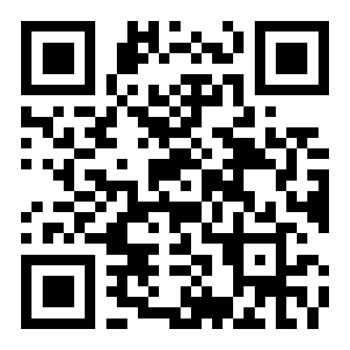
International covenant connections fellowship
ICCF
Yearly Leadership Conferences
Local Leadership Round Table Meetings
Weekly Leadership Training Videos (YouTube.com/@ICCFLeadership)
Church Leadership Coaching
And More!
Sign UP for MORE info at ICCF.us

Slide 4
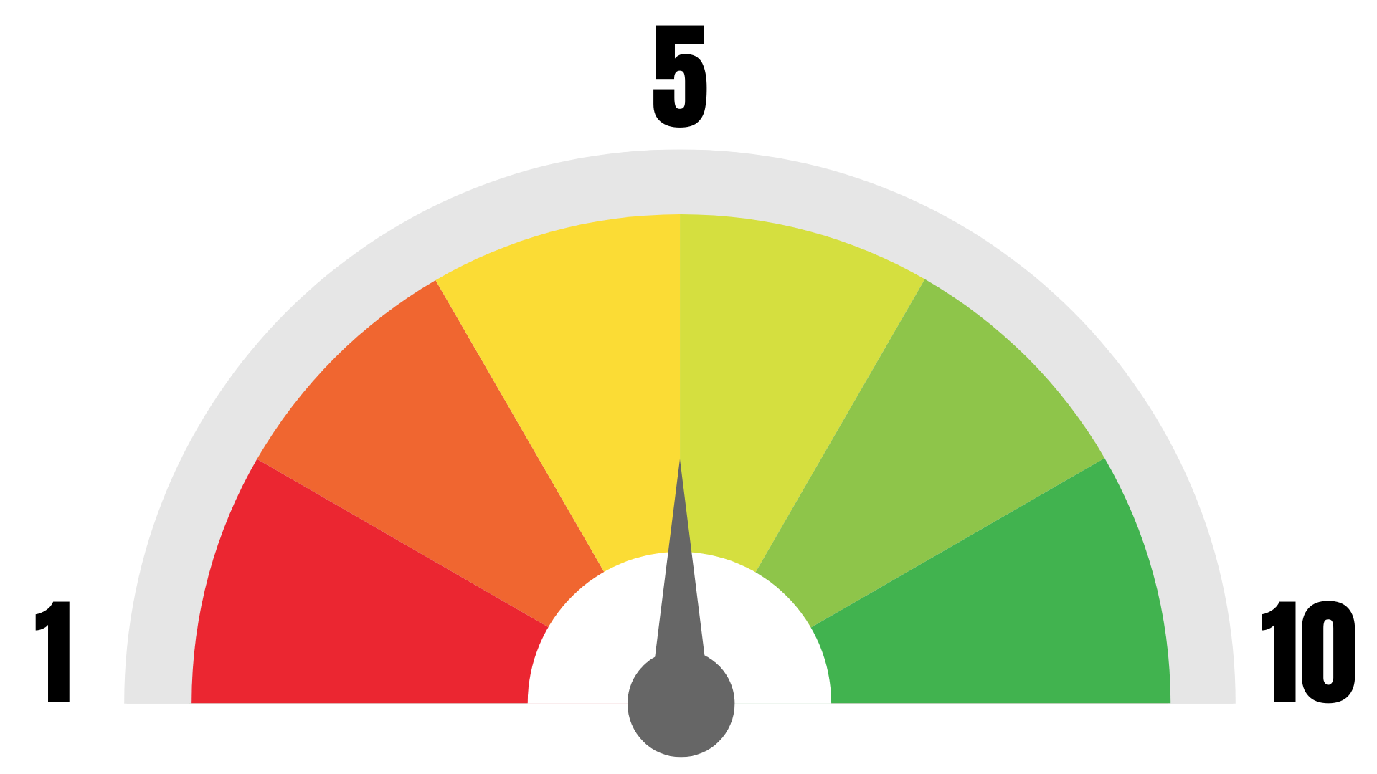
Where are you?
Where would you rate your leadership ability?
Notes:
- Scale: 1-10, Where would you rate your leadership ability?​
- ARE we truly fulfilling our DESTINY?​
PRAY: We ask for the Spirit of wisdom, revelation & knowledge today!​
Pastor Daryl’s Testimony:​
Called, Vision, Raising up Jesus, Not Compromising – But not growing properly – Needed Leadership!​
BUT, I would study leadership, see where I wanted to be, but still lacked the knowledge & ability to get there! This organizational leadership solves that problem.​
What I’m giving you today will be enough to keep you busy for AT LEAST 5 years!​
And should give you the tools to take you from nothing to a very successful organization WITH leaders!​
Today will be a large overview or snapshot.
Many of these elements have more in depth teachings!
Story of leadership training:​
- Raised in leadership, entrepreneurial, USMC, business​
- Thought I was a leader- Found out I wasn’t​
- Didn’t want secular & corporate leadership in the church​
- Pastors JB Whitfield & Chris DiCiaccio- 20 years of leadership application & scripture​
- I had to repent for not teaching the Word​
- What worked in the secular fields, worked because it was based on the WORD!​
When we employed this process, our ministry & life immediately went to a higher level!​

Slide 5
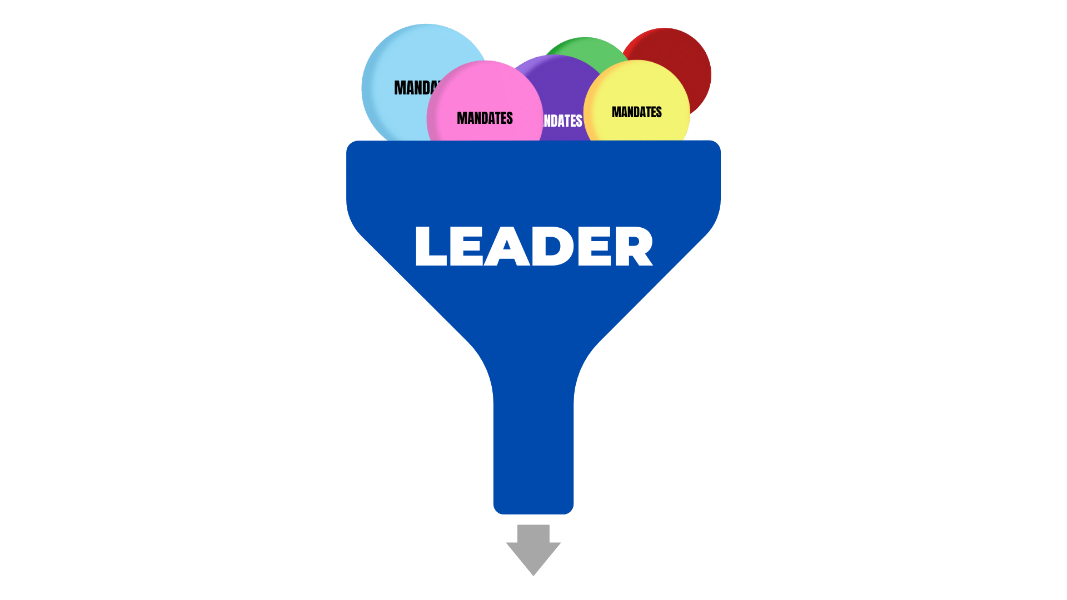
Have you ever Felt like this?

Slide 6
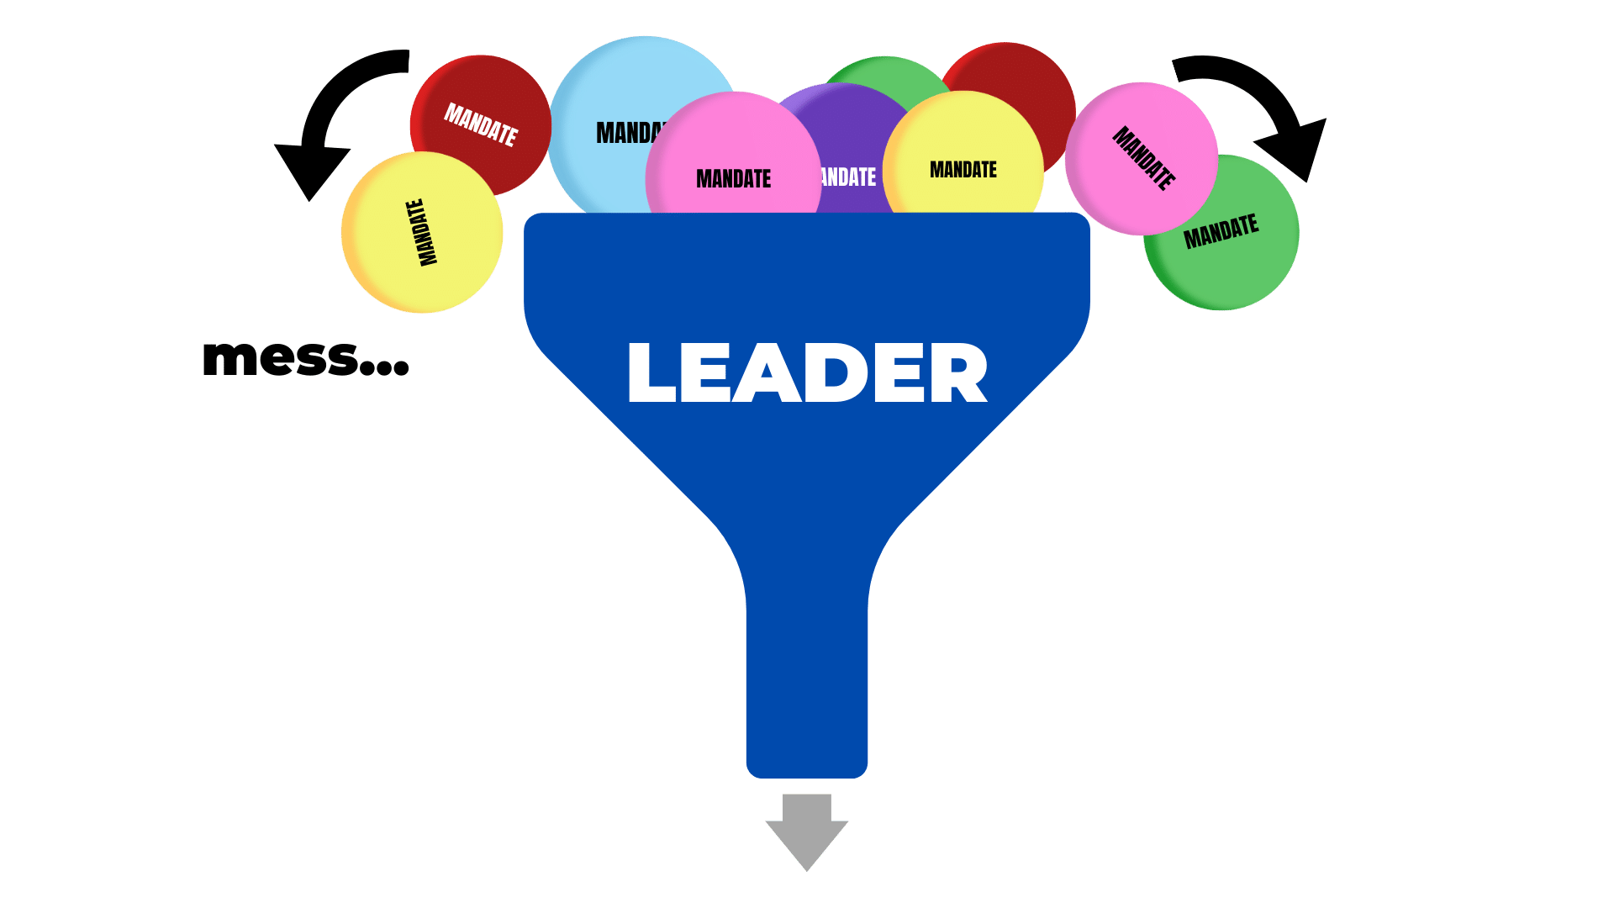
How about this?
Notes:
What I’m about to share with you:
How to handle your destiny
The mechanics of leadership & teams
BUT 1st some thought processes that MUST precede the mechanics
Let’s JUMP into that now!

Slide 7

Why grow in leadership?
To personally grow and be successful
To fulfill our purpose and destiny
To increase in efficiency and productivity
To bring success to our organization
To help others meet their purpose and destiny

Slide 8

Why grow in leadership?
Burying our potential doesn’t please God
  Matthew 25:14-30: The Parable of the Talents
Jesus sets the example of increase
  Luke 2:52: “And Jesus KEPT increasing in wisdom, and stature [maturity], and in favor with God and men.” (NASB)
  LEADERSHIP AFFECTS EVERYTHING
Notes:
In all of this, we are ALWAYS training-- always!

Slide 9

4 types of leaders
The Focus:
  1. POSITIONAL
  2. RELATIONAL
  3. OPERATIONAL
  4. DEVELOPMENTAL
  Authority
  Friendship
  Results
  Replication
Notes:
4 Kinds of Leaders:​
Positional​
Authority – Leads by their position or title - “It’s my way or the highway!”​
Relational​
Friendship – Wants everyone to love them – tries to be everyone’s friend​
Operational​
Results – Focused on the bottom line – tries to meet everyone’s needs/goals​
Developmental​
Replication/Duplication – Jesus did this for 3.5 years & changed the world!

Slide 10
3 leadership roles
Doing
Managing
Leading
Notes:
None of these roles are bad or lesser.
Each has a specific purpose to accomplish vision.
It’s important to recognize which role you should be operating in on each team.

Slide 11
Key phrases
Leadership Affects everything
You can’t do everything…
but you can lead many things!
Repetition is the motor of learning
Growth without change is impossible
Notes:
1. Leadership touches & affects everything.​
2. Our time, resources & efforts are limited.​
We must duplicate ourselves!​
​3. How did we learn our ABCs? The multiplication tables? REPETITION​
2Pe 1:12-15 (NASB) “Therefore, I will always be ready to remind you of these things, even though you already know them… to stir you up by way of reminder…that at any time after my departure you will be able to call these things to mind.”

Slide 12
Leadership keys to remember
Don’t do it alone
Don’t do it for them
Don’t fix it for them
Don’t do your best; do whatever it takes
We are helping to make people more productive
GROWTH WITHOUT CHANGE IS IMPOSSIBLE!
Notes:
If you don’t do these well, you will NOT DEVELOP & DUPLICATE yourself!​
Do what it takes:​
Our best is relative to our environment & training​
2 Peter 1:3 God has given us everything we need to do what it takes​
We step into that by faith​
REMEMBER! GROWTH without CHANGE is impossible!​
YOU CAN CHANGE!​
SMALL vs BIG Messes:​
In doing all this, we are training. ​
That will cost us some time & create messes, but in the end, there will be fewer messes & we’ll be able to do more. ​
It’s easier to clean up a lot of little messes than one leader imploding because he’s trying to do it alone.​
-Repetition is the motor of learning.​
​

Slide 13
The importance of
Culture
Proper culture will do the work for you!
Culture eats vision for breakfast.
-Ps. J.B. Whitfield
If your vision & culture don’t line up, you’ll never accomplish your vision.
-Ap. Bill Motley

Slide 14
Creating
Culture
Identify the culture you should have
Identify the present culture
Share vision & proper culture
Give anointed preaching & teaching on Culture
  This will break the yoke of bad culture
  Create a hunger for the right culture
Model the right culture
Disciple the right culture
Celebrate the right culture
KEEP the right culture by REPEATING

Slide 15

Let’s talk about a process…
Notes:
Take up the sheet with numbers on it.​
Take a look at it​
Place it face down​
You will find the #1 & circle it​
Then you will find the #2​
Then you will continue in order as high as you can for 1 minute​
Whoever has the highest number wins!​
Ready? GO!​
Who has the highest?​

Slide 16

What is a process?
PROCESS:
A series of actions or steps taken in order to achieve a particular end
Notes:
Now take the 2nd numbers sheet & fold it in half from top to bottom & left to right.​
NOTICE the #1 is in the top left quadrant.​
The #2 is clockwise in the top right quadrant.​
If you continue clockwise the #3 will be in the bottom right.​
#4 will be in the bottom left, continuing clockwise.​
The numbers will now continue to follow that pattern/process.​
You have 1 more minute to break your record!​
Ready? GO!​

Slide 17

Change is a necessity
Notes:
We must go up to reach our destiny.​
You’ll find that as we grow, we will reach a new level & then get acquainted with the new level.
We must get acquainted with it to lead properly, but we must not stay there!
BUT each new level requires change!​

Slide 18
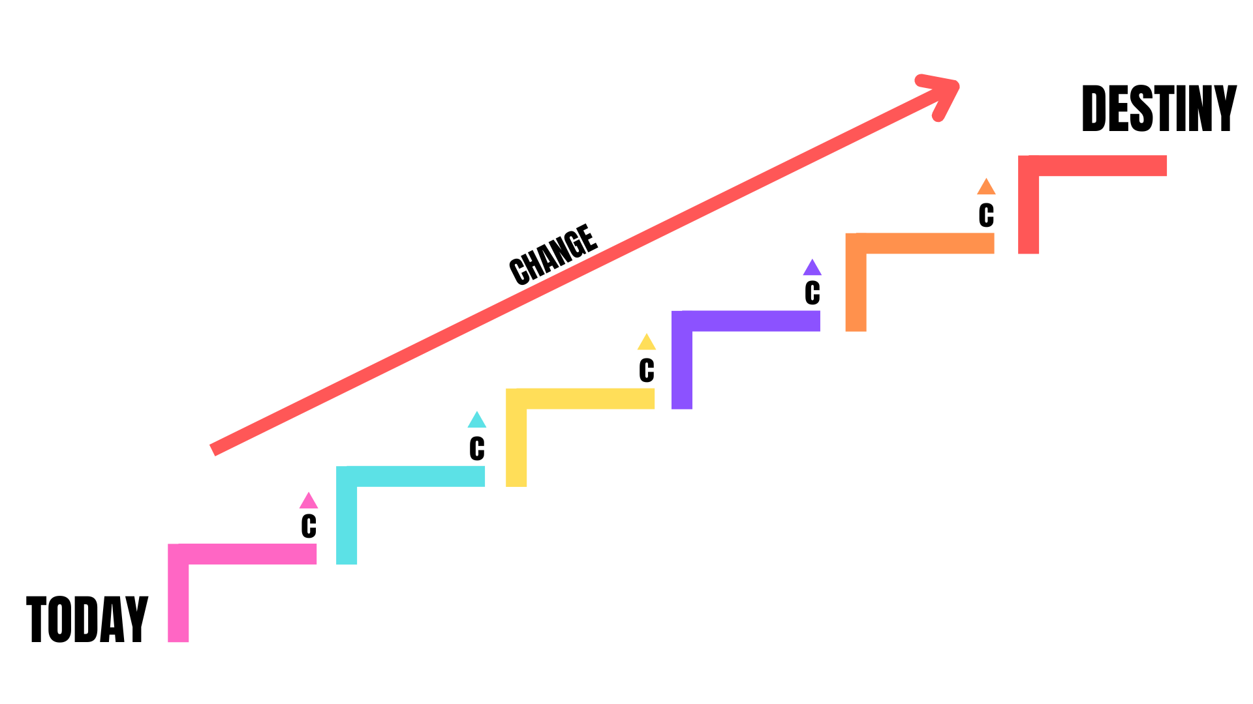
Change is a necessity
Notes:
We MUST change & GROW to meet our destiny!​
If we do not change, we will NOT grow!​
GROWTH without CHANGE is IMPOSSIBLE!​

Slide 19
3 types of people
RESIST Change
TOLERATE Change
EMBRACE Change
Notes:
The majority of people RESIST change.​
People will grow as you, the leader, grows.​
It is a very rare individual that will grow beyond their leader.​
We need to take responsibility for that.​
We want to be the 3rd type: We EMBRACE change!​
(I’m not talking about compromising.)​

Slide 20
Change is a necessity
FACE REALITY!
Two things that promote change:
      Crisis
      Revelation
Notes:
If we are going to change we MUST face reality!​
2 things that promote change:​
Crisis​
Revelation​

Slide 21

I + P = O
Issues + problems = opportunities
Notes:
Issues & Problems = Opportunities​
2 Corinthians 2:14 (NASB) But thanks be to God, who always leads us in triumph in Christ, and manifests through us the sweet aroma of the knowledge of Him in every place.​
We need to believe that God will always lead us to triumph in the middle of issues & problems!​
Then we will start looking at issues & problems with faith filled eyes instead of dread.​

Slide 22
The growth process
See Issues & Problems
  Face Reality thru Crisis & Revelation
    Change!
      Grow!
        Reach Your Destiny
Notes:
What is the GROWTH Process?​
See Issues & Problems > Face Reality Thru Crisis or Revelation > Make a Change > Grow > Reach Your Destiny​
We will repeat this Growth Process OVER & OVER & OVER again to grow & fulfill our destiny!
REMEMBER! Growth without change is impossible!
TAKE A BREAK?​

Slide 23
The process of leadership
CLOSING THE GAP
MENTAL ASSENT
    (What we know)
2. APPLICATION
    (Actually doing)
3. TEACH
    (What we pass on)
THE GAP
Notes:
We need to always be thinking about closing the gap.​
This is where Leadership actually happens.​
We don’t just need to KNOW what to do, we ACTUALLY need to GET IT DONE!​
ACTUALLY:​
Forgive​
Be in expectation​
Be Discipled​
Examples:​
Teenagers KNOW to clean their room​
We know we should eat well & exercise​
People should do more in the church​
Find your joy again & REALLY LIVE!​
Can we actually be in joy if we are not actually DOING what we should be?​
We need to get to Mobilization! ​
We can’t just know of an issue, we must take action!​
And then REPLICATE ourselves!
WE MUST CLOSE this gap!

Slide 24
The process of leadership
CLOSING THE GAP
MENTAL ASSENT
    (What we know)
2. APPLICATION
    (Actually doing)
3. TEACH
    (What we pass on)
RECOGNIZE
Prioritize
CLOSING
THIS GAP
THE GAP
Mobilize
Notes:
In order to close the gap we:
Recognize -> Prioritize -> Mobilize​
Recognize the change that needs to take place.
Prioritize those changes
Mobilize teams to make the changes & fulfill vision
The Process of Leadership is CLOSING THAT GAP!​
We need to always be thinking about closing this gap.​
We need to get to MOBILIZATION then to REPLICATION.​
We complete this process by applying other processes like…​
The Proverbs Process & The Timothy Process​

Slide 25
THE PROVERBS PROCESS | Gifts
“And the spirit of the LORD shall rest upon him, the spirit of wisdom and understanding, the spirit of counsel and might, the spirit of knowledge and of the fear of the LORD;”
Isaiah 11:2 (KJV)
Notes:
Proverbs 23:23 NASB Buy truth, and do not sell it, Get wisdom and instruction and understanding.​
OFTEN you will hear me pray for the spirit of wisdom, revelation/understanding & knowledge!​

Slide 26
THE PROVERBS PROCESS
Isaiah 11:2 Gifts | Proverbs 24:3-4 KJV Living Fruit How? |  | Leader Work | Team Work
Knowledge
Understanding
Wisdom

Slide 27
THE PROVERBS PROCESS | Fruit
“By wisdom a house is built, And by understanding it is established; and by knowledge the rooms are filled with all precious and pleasant riches.”
Proverbs 24:3-4 (NASB)

Slide 28
THE PROVERBS PROCESS
Isaiah 11:2 Gifts | Proverbs 24:3-4 KJV Living Fruit How? |  | Leader Work | Team Work
Knowledge | Filled with Riches
Understanding | Established
Wisdom | Built

Slide 29
THE PROVERBS PROCESS | How?
“Any enterprise is built by wise planning, becomes strong through common sense, and profits wonderfully by keeping abreast of the facts.”
Proverbs 24:3-4 (Living Bible)

Slide 30
THE PROVERBS PROCESS
Isaiah 11:2 Gifts | Proverbs 24:3-4 KJV Living Fruit How? |  | Leader Work | Team Work
Knowledge | Filled with Riches | “Facts”
Understanding | Established | Common Sense
Wisdom | Built | Wise Plan

Slide 31
THE PROVERBS PROCESS
Isaiah 11:2 Gifts | Proverbs 24:3-4 KJV Living Fruit How? |  | Leader Work | Team Work
Knowledge | Filled with Riches | “Facts” | Recognize
Understanding | Established | Common Sense | Prioritize
Wisdom | Built | Wise Plan | Mobilize

Slide 32
The process of leadership
CLOSING THE GAP
MENTAL ASSENT
    (What we know)
2. APPLICATION
    (Actually doing)
3. TEACH
    (What we pass on)
RECOGNIZE
See the Goal
Face Reality
  Crisis
  Revelation
Recognize
Prioritize
Mobilize Team
  Issues + Problems = Opportunities
Application
Teach
Prioritize
CLOSING
THIS GAP
THE GAP
Mobilize
Notes:
When you MOBILIZE the team, they will face Issues & Problems.
That’s when we help turn them to opportunities!
Here are our duplicatable, teachable moments!

Slide 33
THE PROVERBS PROCESS
Isaiah 11:2 Gifts | Proverbs 24:3-4 KJV Living Fruit How? |  | Leader Work | Team Work
Knowledge | Filled with Riches | “Facts” | Recognize | Issues
Understanding | Established | Common Sense | Prioritize | Problems
Wisdom | Built | Wise Plan | Mobilize | Opportunities
Notes:
So we see the Leader’s work vs the Team’s work.

Slide 34
Teams are the fundamental
building unit of any organization!
The need for teams

Slide 35

The need for teams
Acts 6:1-7
  The Mandate is Bigger than You
Exodus 17:8-13
  The Burden is Carried with Help
Exodus 18:13-23
  Success is Gained through Teams
Notes:
In order to complete these processes, we need teams!​
Acts 6:1-7 NASB Now at this time while the disciples were increasing in number, a complaint arose on the part of the Hellenistic Jews against the native Hebrews, because their widows were being overlooked in the daily serving of food. (2) So the twelve summoned the congregation of the disciples and said, "It is not desirable for us to neglect the word of God in order to serve tables. (3) "Therefore, brethren, select from among you seven men of good reputation, full of the Spirit and of wisdom, whom we may put in charge of this task. (4) "But we will devote ourselves to prayer and to the ministry of the word." (5) The statement found approval with the whole congregation; and they chose Stephen, a man full of faith and of the Holy Spirit, and Philip, Prochorus, Nicanor, Timon, Parmenas and Nicolas, a proselyte from Antioch. (6) And these they brought before the apostles; and after praying, they laid their hands on them. (7) The word of God kept on spreading; and the number of the disciples continued to increase greatly in Jerusalem, and a great many of the priests were becoming obedient to the faith.​
SEE other scriptures on next page…​

Slide 36
Teams are the fundamental
building unit of any organization!
The need for teams
Notes:
Exodus 17:8-13 NASB Then Amalek came and fought against Israel at Rephidim. (9) So Moses said to Joshua, "Choose men for us and go out, fight against Amalek. Tomorrow I will station myself on the top of the hill with the staff of God in my hand." (10) Joshua did as Moses told him, and fought against Amalek; and Moses, Aaron, and Hur went up to the top of the hill. (11) So it came about when Moses held his hand up, that Israel prevailed, and when he let his hand down, Amalek prevailed. (12) But Moses' hands were heavy. Then they took a stone and put it under him, and he sat on it; and Aaron and Hur supported his hands, one on one side and one on the other. Thus his hands were steady until the sun set. (13) So Joshua overwhelmed Amalek and his people with the edge of the sword.​
SEE other scriptures on next page…​
Just because we can carry it alone, doesn’t mean we should!​
NICOLE EXAMPLE: Carrying grocery bags​

Slide 37
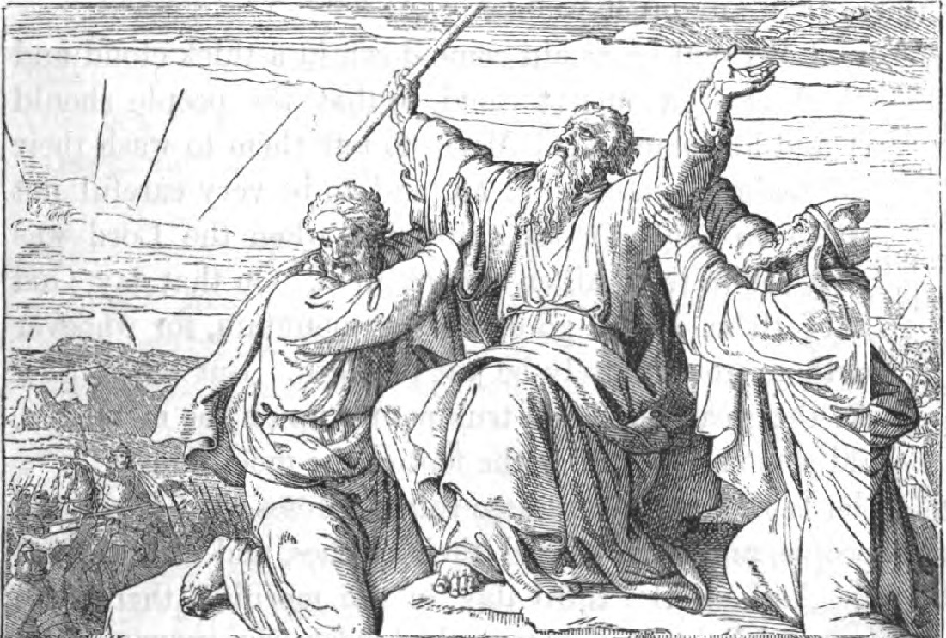
Executive leadership team
Notes:
AFTER​
Exodus 18:13-23 NASB It came about the next day that Moses sat to judge the people, and the people stood about Moses from the morning until the evening. (14) Now when Moses' father-in-law saw all that he was doing for the people, he said, "What is this thing that you are doing for the people? Why do you alone sit as judge and all the people stand about you from morning until evening?" (15) Moses said to his father-in-law, "Because the people come to me to inquire of God. (16) "When they have a dispute, it comes to me, and I judge between a man and his neighbor and make known the statutes of God and His laws." (17) Moses' father-in-law said to him, "The thing that you are doing is not good. (18) "You will surely wear out, both yourself and these people who are with you, for the task is too heavy for you; you cannot do it alone. (19) "Now listen to me: I will give you counsel, and God be with you. You be the people's representative before God, and you bring the disputes to God, (20) then teach them the statutes and the laws, and make known to them the way in which they are to walk and the work they are to do. (21) "Furthermore, you shall select out of all the people able men who fear God, men of truth, those who hate dishonest gain; and you shall place these over them as leaders of thousands, of hundreds, of fifties and of tens. (22) "Let them judge the people at all times; and let it be that every major dispute they will bring to you, but every minor dispute they themselves will judge. So it will be easier for you, and they will bear the burden with you. (23) "If you do this thing and God so commands you, then you will be able to endure, and all these people also will go to their place in peace.“​
​

Slide 38
Kinds of teams
ELT
FUNCTIONING TEAM
BUILDING TEAM
Cast Vision &
Empower Teams
Manage & Plan
Do & Accomplish
Creates plans, ideas, & recommendations to help accomplish the vision
Carries out the work of the vision
The primary Building Team of the organization

Slide 39
Executive leadership team
MOSES
LEADERSHIP TEAM
HUR
AARON

Slide 40
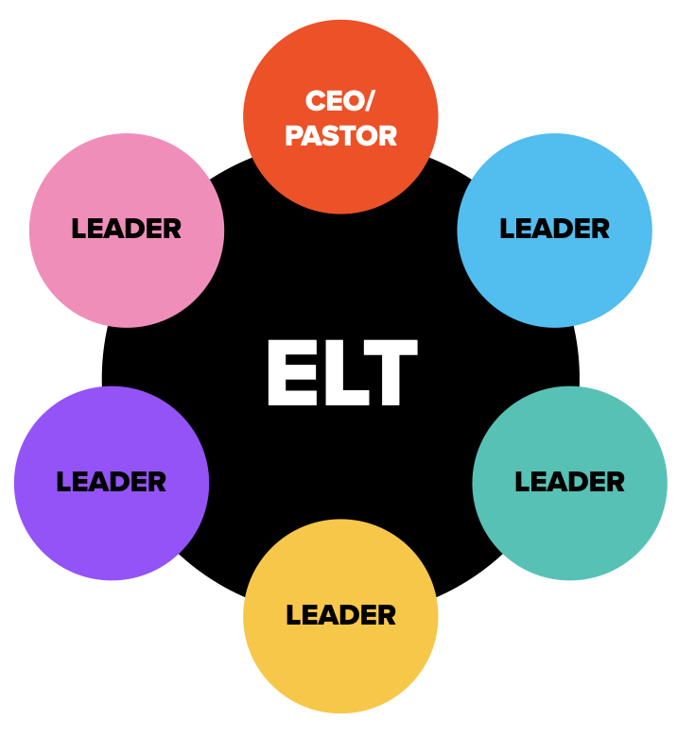
Executive leadership team
Optimal leadership team has no more than 5 team members
Notes:
This is not an absolute, but a guideline from experience in action.​

Slide 41
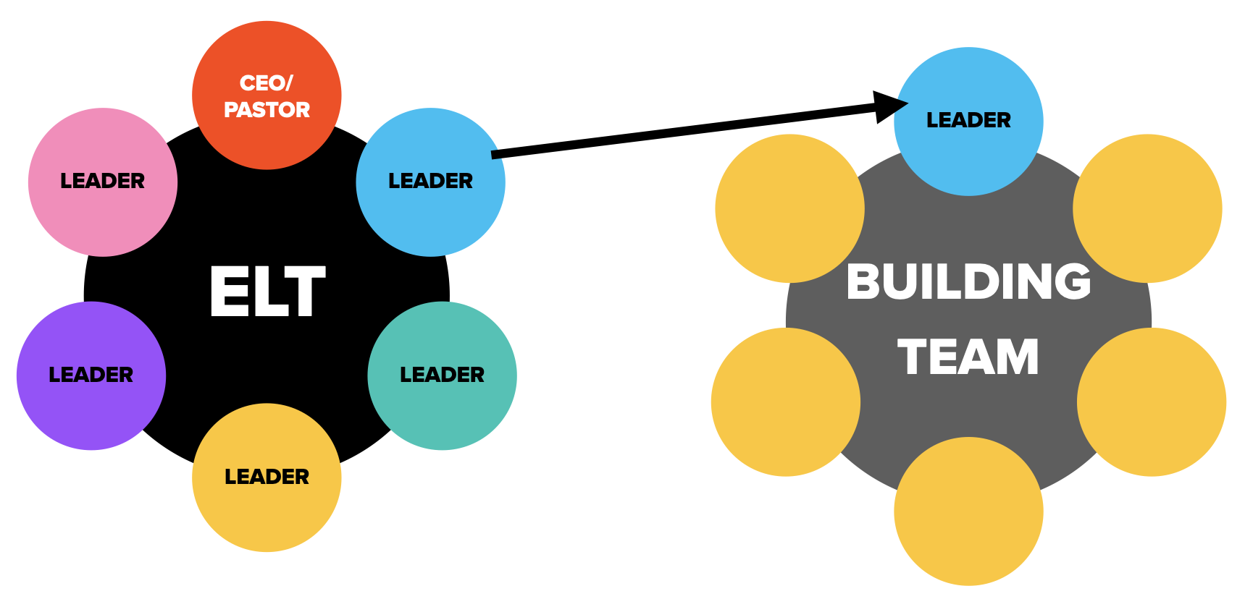
Executive leadership team

Slide 42
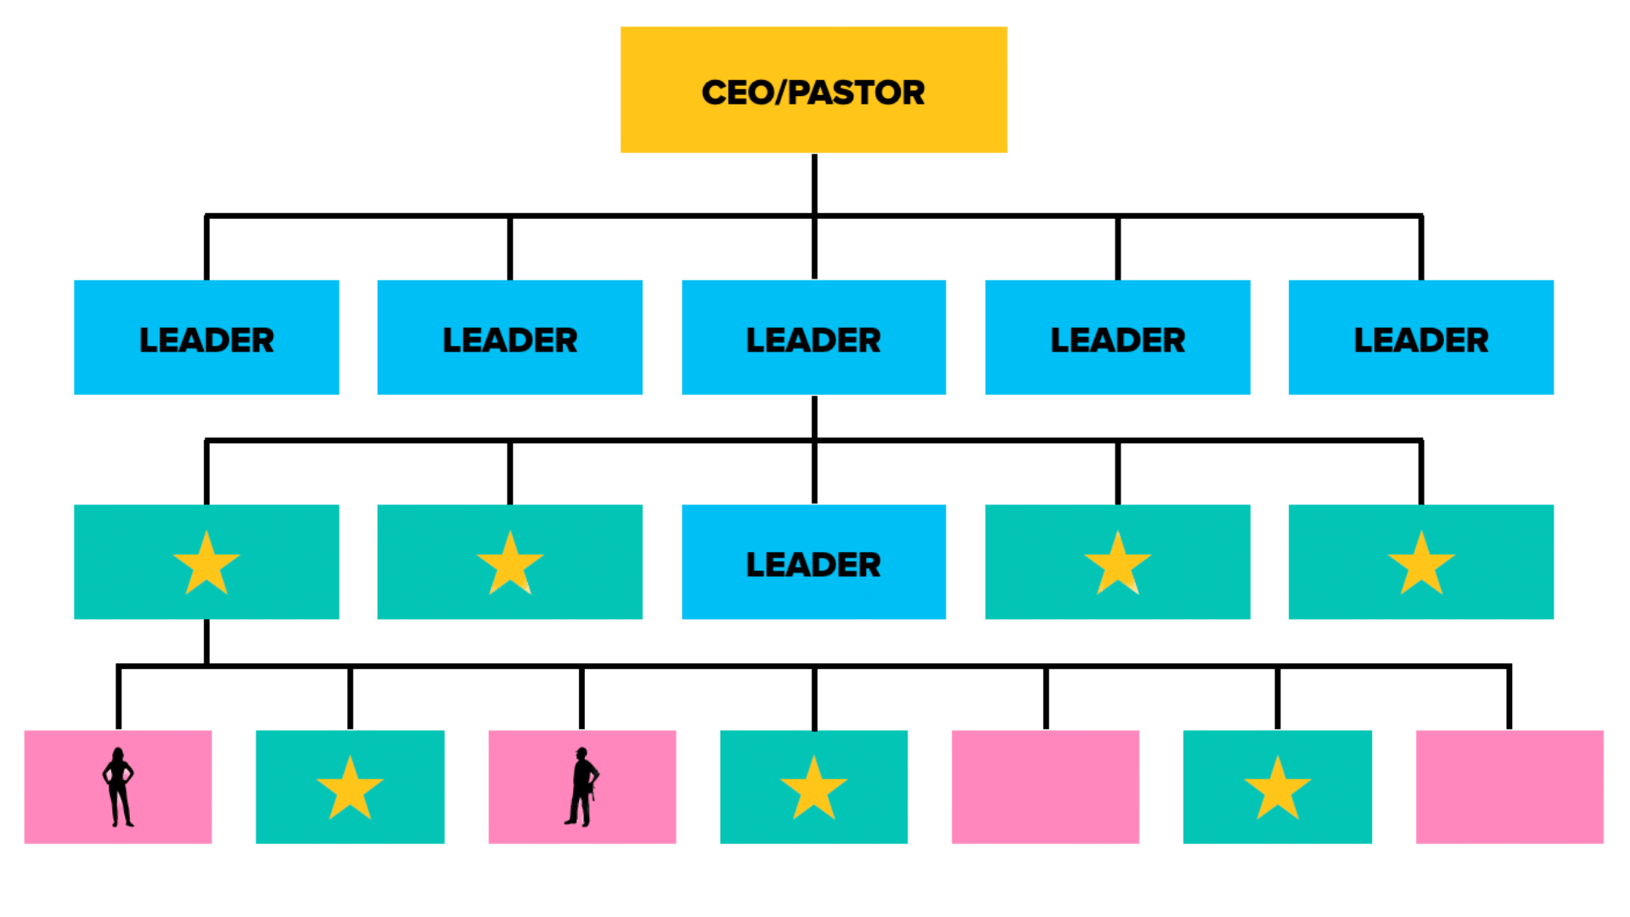




Kinds of teams
ELT
BUILDING TEAM
FUNCTIONING TEAM

Slide 43

The Timothy Process
GOD SENDS PEOPLE YOUR WAY

Slide 44
The Timothy Process
“You therefore, my son, be strong in the grace that is in Christ Jesus. The things which you have heard from me in the presence of many witnesses, entrust these to faithful men who will be able to teach others also.”
2 Timothy 2:1-2 (NASB)

Slide 45
CTTM: COACH, teach, train, mentor
YOUR JOB: INCREASE PRODUCTIVITY IN PEOPLE
Notes:
Every person that comes into your organization needs to be put in the pipeline to becoming a responsible & more fruitful, efficient & productive person!​

Slide 46

THE TIMOTHY Process
COACH
TEACH
TRAIN
MENTOR
YOUR VISION: THEIR DESTINY
Notes:
They need to be plugged into the vision for your organization. They join the vision of the organization or the leader. They aren’t just advancing their own.​
Their destiny is wrapped up in YOUR organization!​
Your vision is their destiny!​

Slide 47
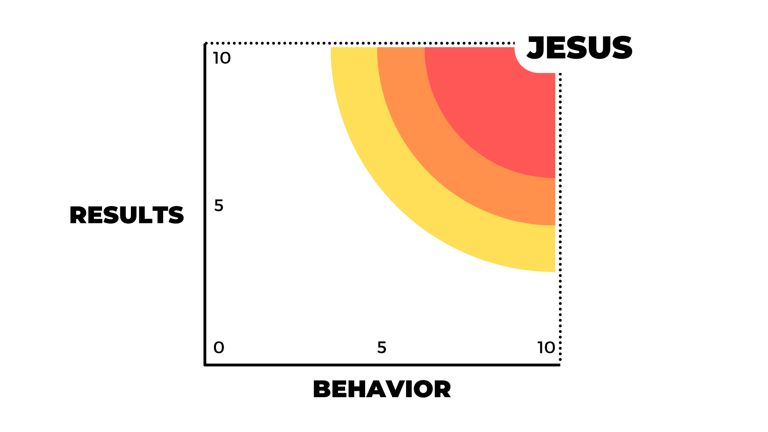
How to Rate Performance
Notes:
As you train people you will need to keep a pulse on their performance & behavior.
With this tool you can rate anything:​
- Year in review​
- Projects​
- Events​
- Teams​
- Individuals​
- etc

Slide 48
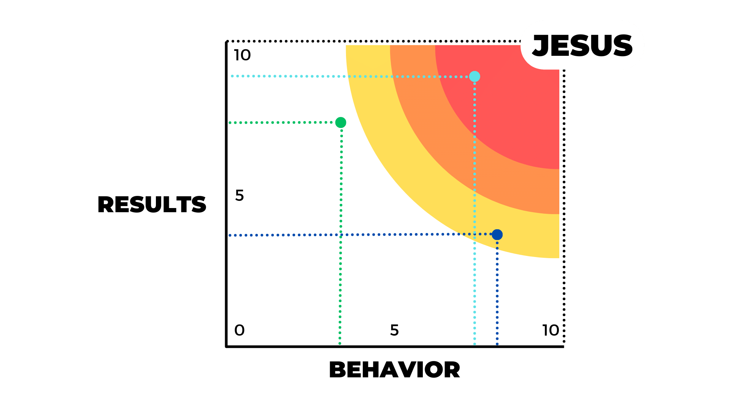
How to Rate Performance

Slide 49
Responding to mandates

Slide 50
Responding to mandates

Slide 51
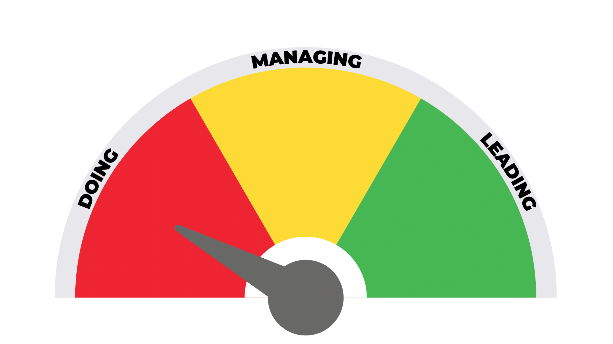
RPM POWER METER
RESPONSE PER MANDATE
Micro
Management
Macro
Management
Low
Minimum
High
Maximum
RPMs
Notes:
See the 3 Roles: EACH should be in their place
IF you are the leader in the DOING area, you will be the clog in the funnel.
If you as the leader are in the “Doing” area, you are robbing God’s people from using their gifts.​
If you are allowing your leader to do that, you are assisting in the robbery.​
They need to sow their gifts & reap the fruit that it will produce. We cannot rob them of their harvest.​
EXAMPLE: Orchestra Leader​
When doing, your org has no leader​
”It’s easier to do it myself”​
“I like the praise”​
At this LOW output the organization is dysfunctional at best.​
Leader’s loss of intimacy with God​
Major mistakes are made​
Major opportunities missed​
Leaders are not developed​
​

Slide 52
Responding to mandates
Notes:
If you are a leader in the DOING area, this is what will happen.

Slide 53
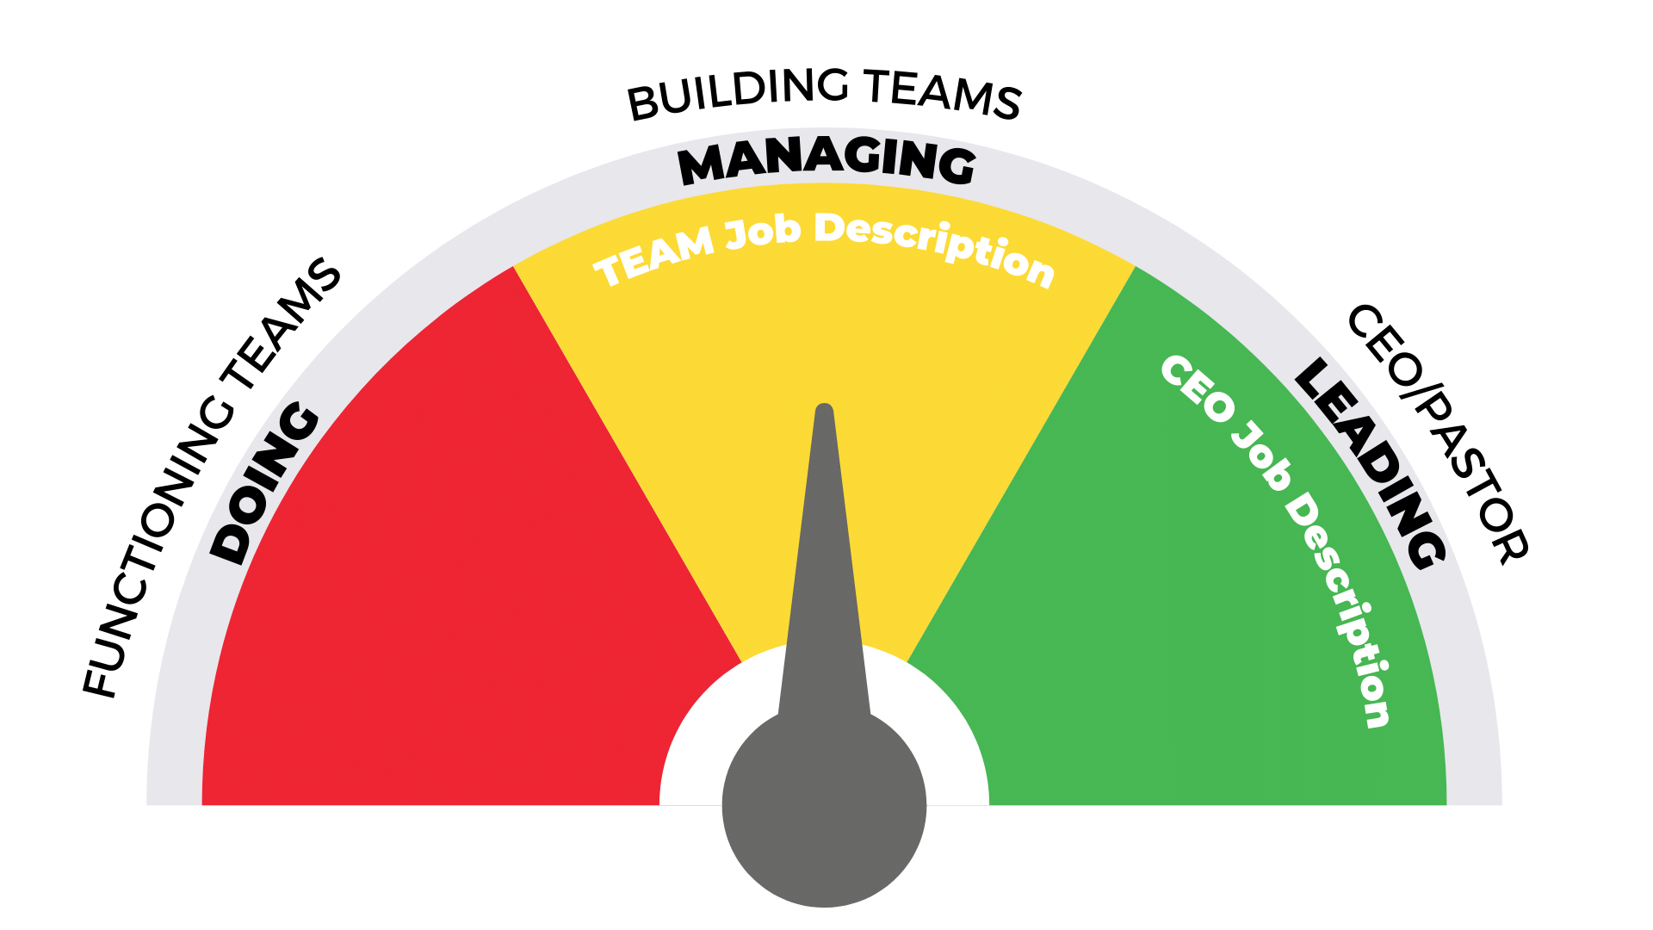
RPM POWER METER
RESPONSE PER MANDATE
Micro
Management
Macro
Management
Low
Minimum
High
Maximum
RPMs
Notes:
Each Type of Team has a POWER area

Slide 54
JOB DESCRIPTIONS
CEO
Provide Vision & Direction
Obtain & Review P.I.R.
    (Plans, Ideas, & Recommendations)
Commission the Plan OR Redirect it
Provide Resources for Their Success: CTTM
Obtain Evaluation & Mandate Accountability
TEAM
Protect the Flow of the Anointing (Protect the integrity & production of the organization)
Do What it Takes to Accomplish Vision
CPIR: Create Plans, Ideas, & Recommendations
Report the Pulse (See that methods, systems, procedures of reporting are put in place & adhered to so the CEO has a pulse on the organization
Notes:
Evaluation & Accountability-​
Write this down: SADI: Supposed, Actually, Difference, Improvement
4 Post Event Questions:​
What was supposed to happen?​
What actually happened?​
What made up the difference?​
What can we do to improve?​

Slide 55
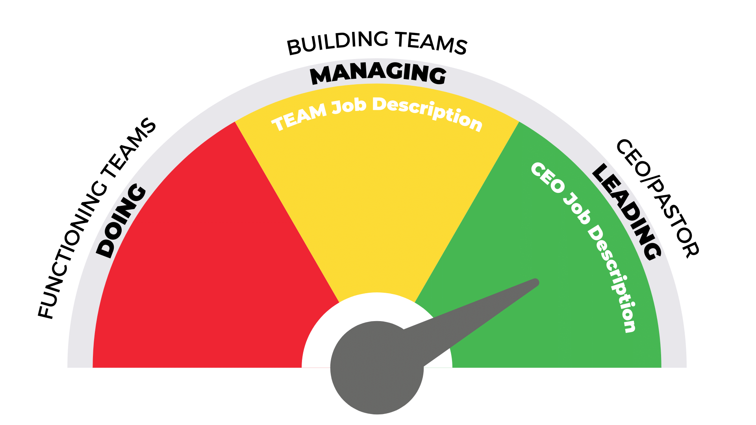
RPM POWER METER
RESPONSE PER MANDATE
Micro
Management
Macro
Management
Low
Minimum
High
Maximum
RPMs

Slide 56
Responding to mandates

Slide 57
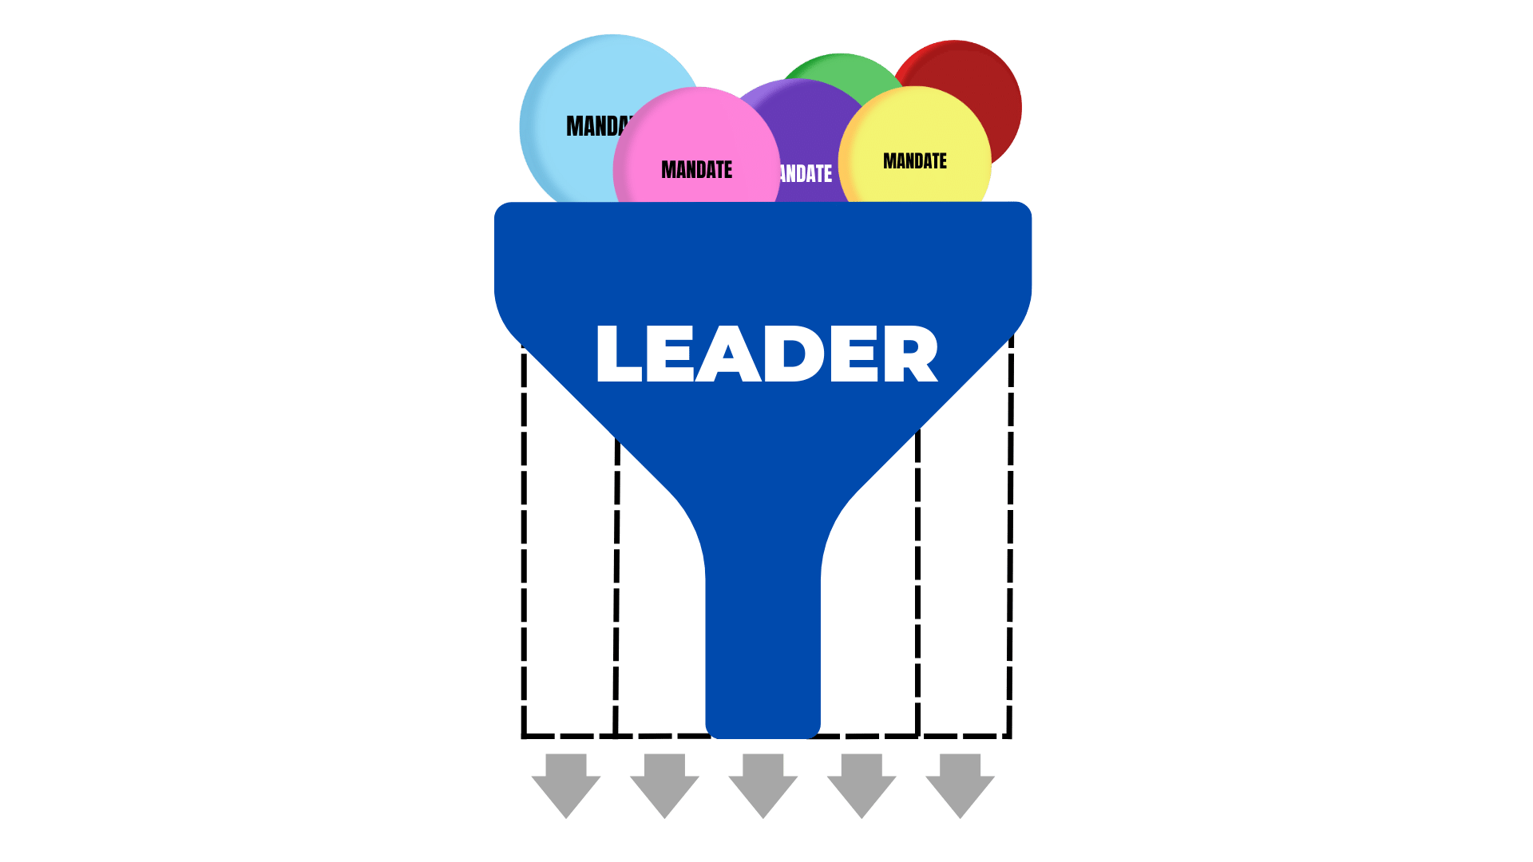
Responding to mandates
Widen the funnel!!!

Slide 58
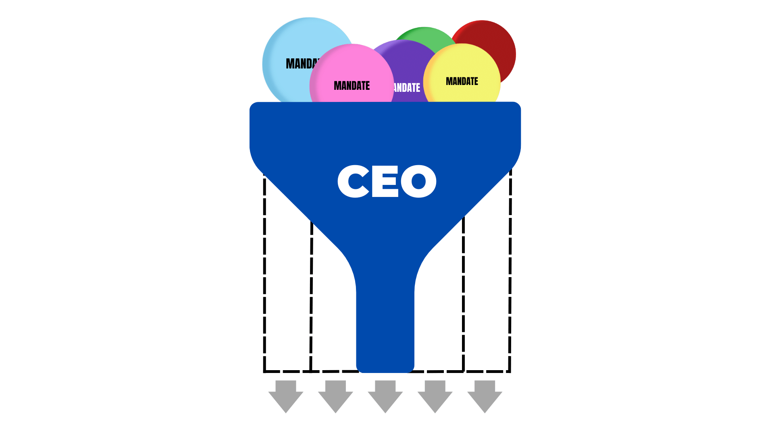
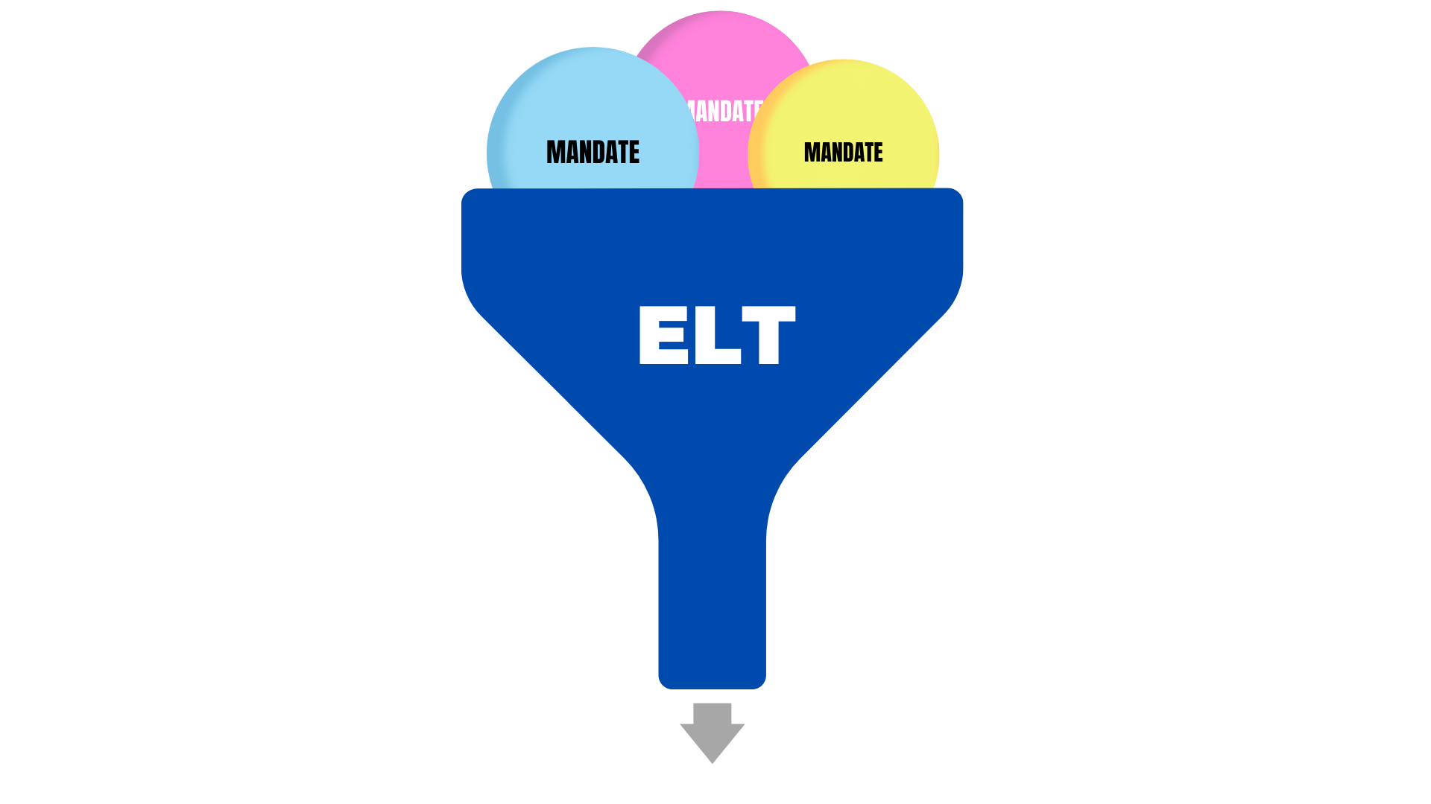
Responding to mandates
CTTM:
COACH
TEACH
TRAIN
MENTOR
3 Levels of
leadership
DELEGATE
Empower
Entrust
ELT
Notes:
A STAR slide!
How do we help build better teams?​
1- CTTM​
2- Delegating, Empowering & Entrusting​
3 Levels of Leadership:
Delegate: Give them the right to participate​: Babysit- in town
Empower: Give them the right to contribute​: Babysit- out of town
Entrust: Give them the right to be faithful: Babysit- out of country​

Slide 59
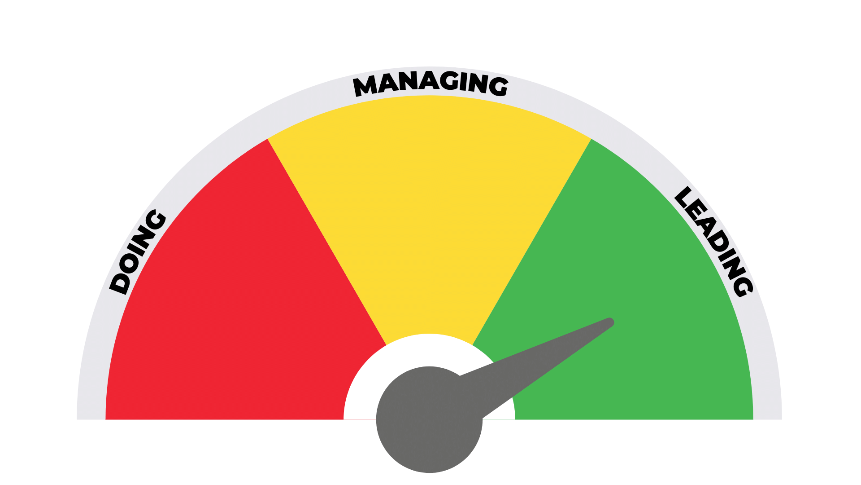
RPM POWER METER
RESPONSE PER MANDATE
Low
Minimum
High
Maximum
RPMs

Slide 60
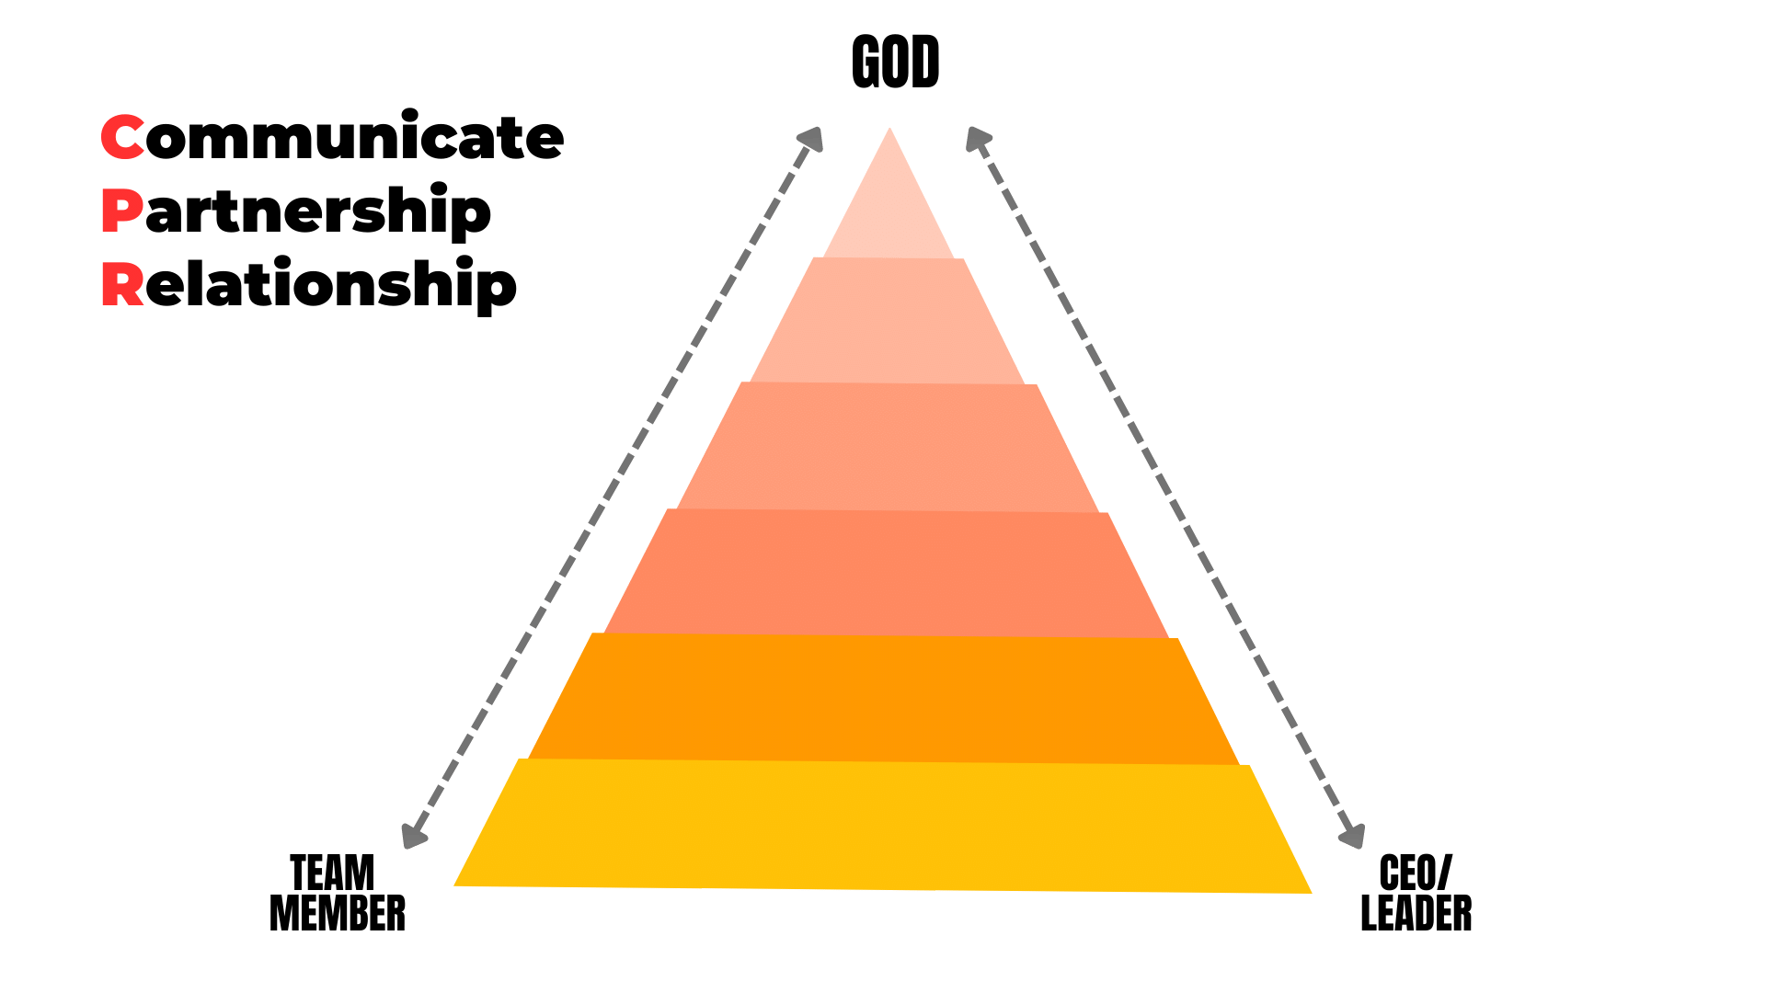
Proper cpr

Slide 61
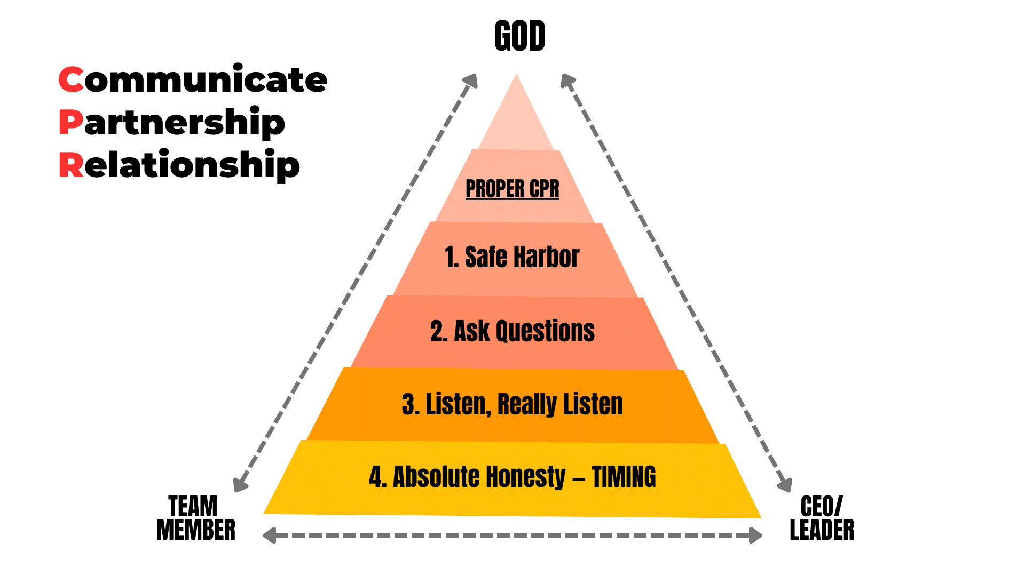
Proper cpr

Slide 62
Proper cpr
THEY HAVE:
Wise Counsel
Facts
Background
Experience
Ideas
Perspective
Knowledge
Notes:
CTTM:​
Jesus asked questions.​
The questions drew them into their own discovery & revelation.​
ASK Questions. ​
Get Feedback. (What would you do different? Why should we do it this way? etc…)​
Do NOT ask judgmental harsh questions. (What knucklehead thought this was a good idea?)

Slide 63
Team Workflow & Communication
Vision/Planning
Operation
Evaluation
CEO:
Provide Vision & Direction
Redirect back
to the team
commission
the pir
Obtain evaluation
Is the pir ready?
NO
YES
TEAM:
Create
pir
Review
pir
Carry out
the plan
Evaluate performance

Slide 64
5 dysfunctions of a team
Absence of TRUST
Fear of CONFLICT
Lack of COMMITMENT
Avoidance of RESPONSIBILITY
Inattention to RESULTS
People are afraid of risk; gifts and talents are not used
Artificial harmony
Things become unclear or cloudy because priorities are mismatched
Produces low standards and a “just get by” mentality
Builds improper ego
Notes:
EACH 1 leads to the next dysfunction​
2- Fear of HEALTHY CONFLICT: Artificial harmony; Not facing facts; Not mining out good ideas​
3- LACK OF COMMITMENT: ALSO, things become unclear & cloudy as to what is going to happen & results become hard to find.​

Slide 65
Beginning steps to the leadership process
See the process snapshot (Advanced Leadership Training)
Get personal resolve (See the Word in it and decide)
Choose your ELT
Present the process snapshot to them
ELT gets resolve
Start General CPIR with ELT
Start to develop other teams

Slide 66
Choosing general leaders
CORE CHARACTER COMPETENCIES
Taking Thoughts Captive (Not wishy-washy)
Faithful Tenure
They Think (Innovative Thinking)
Entrepreneural Minded
They Communicate
Carries Emotional Maturity
Flows in the Spirit
Has Good Behavior (Fruits of the Spirit)
Is Respectful
Attracts and Inspires Others

Slide 67
Choosing Your ELT
ELT CORE CHARACTER COMPETENCIES SHOULD INCLUDE:
  Applies the basics of the Word (Fellowship, forgiveness, tithing, taking thoughts captive, gathering, hunger, humility, gentleness, respect, etc.)
  Led by the Spirit and Flows
  Proper Praiseworthy Thinking: Takes Thoughts Captive
  Innovative Thinkers: Sharp, Strategic Mind (Isaiah 11:2)
  Humble, Teachable Spirit: They Want to be Better
  Faithful Tenure & Integrity: 3-Year Rule
  Emotional Maturity: EQ Skills (Ephesians 4:1-3)
  Good Interpersonal Communication Skills (Godly Skills—Seeing & Hearing Through God’s Eyes & Ears)
  Entrepreneurial Building Skills
  Achievers, Focused on Results
  Recruiters: An Ability to Attract & Inspire Other Talent

Slide 68
Where are you?
Where would you rate your leadership ability?
REMEMBER:
FACE REALITY
Notes:
John Maxwell: “On a scale of 1-10 in leadership, most pastor’s are 4’s.”​
4’s can only lead 4’s, 3’s, 2’s & 1’s.

Slide 69
“…Take heed to the ministry which you have received from the Lord, that you may fulfill it.”
Colossians 4:17 (NASB)

